Slide 1

Remembrance 2020
Assembly PowerPoint images to accompany school resources
For more information contact ajexremembers@ajex.org.uk or visit www.ajex.org.uk

Slide 2

The Poppy…

Slide 3
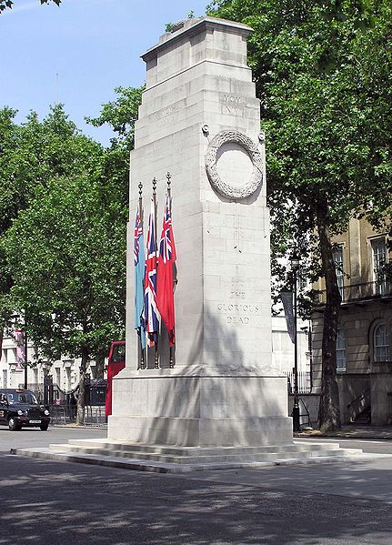
The Cenotaph at the heart of London

Slide 4
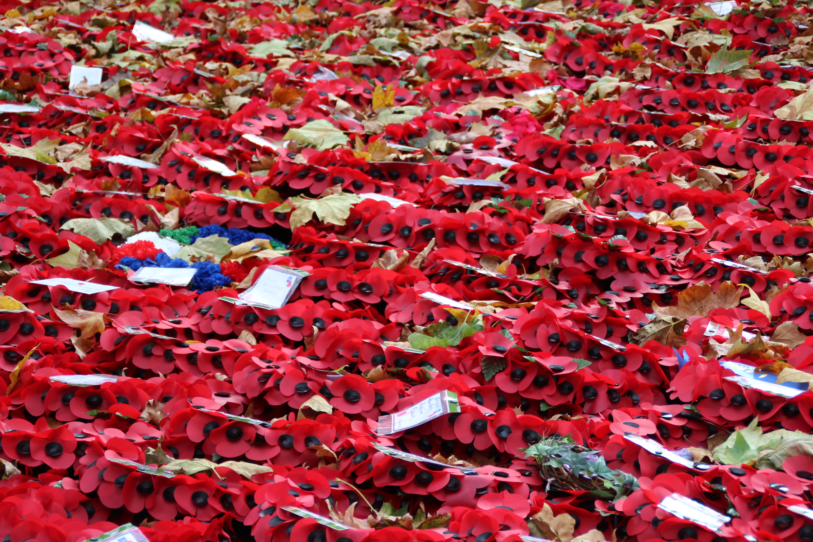
In Flanders Fields by John McCrae
In Flanders fields the poppies blow
Between the crosses, row on row,
That mark our place; and in the sky
The larks, still bravely singing, fly
Scarce heard amid the guns below.
We are the Dead. Short days ago
We lived, felt dawn, saw the sunset glow,
Loved and were loved, and now we lie
In Flanders fields.
Take up our quarrel with the foe:
To you from failing hands we throw
The torch; be yours to hold it high.
If ye break faith with us who die
We shall not sleep, though poppies grow
In Flanders fields.

Slide 5
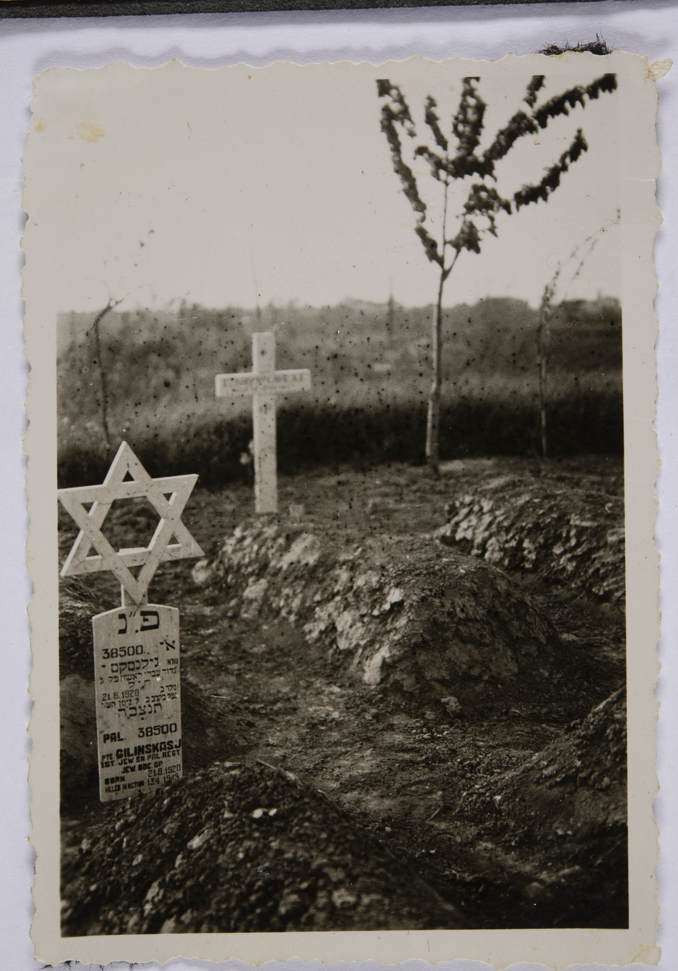
Share a Story for Remembrance

Slide 6
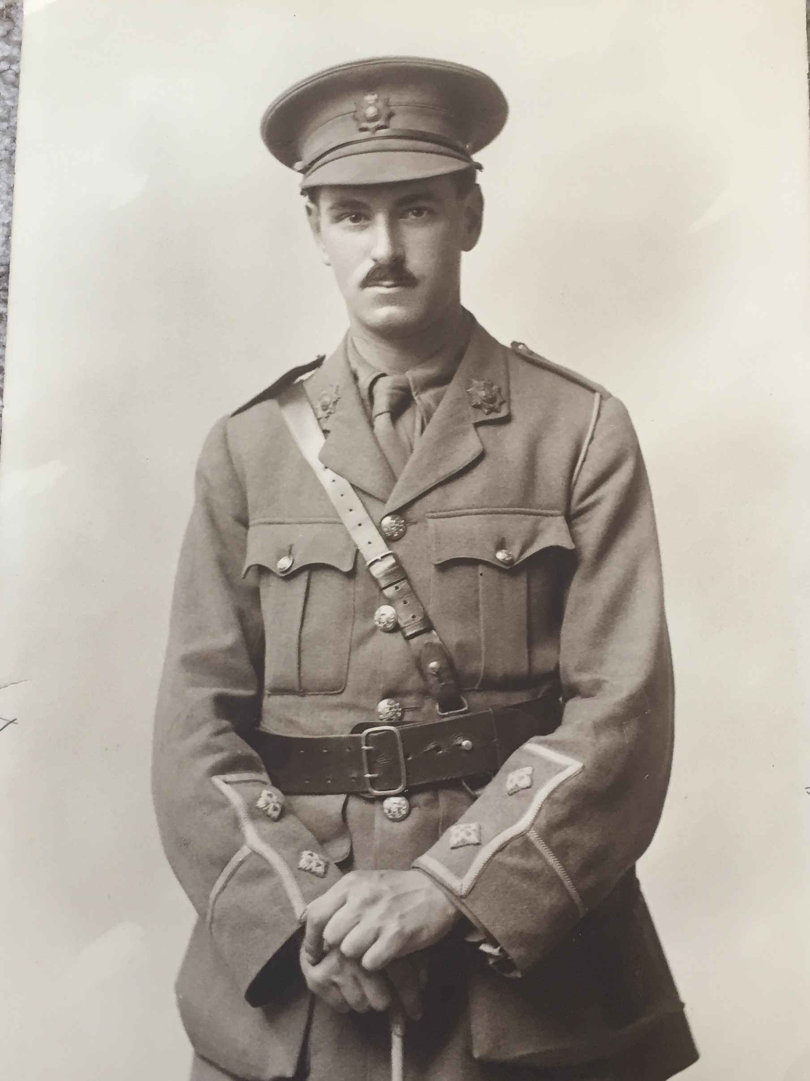
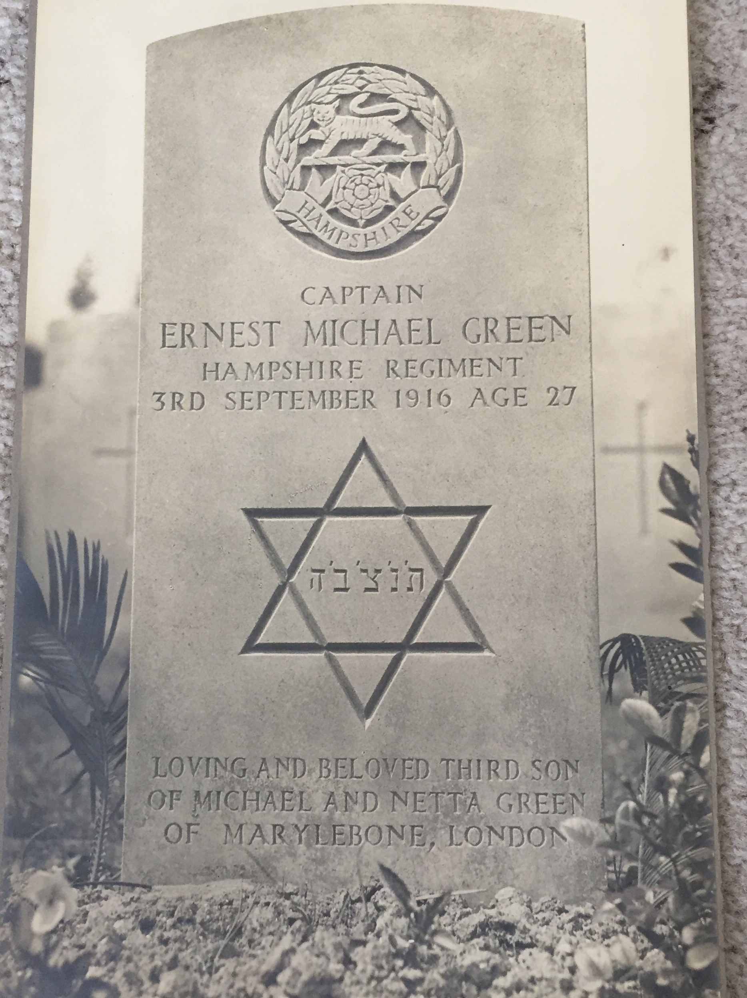
Ernest Michael Green (1888 – 1916)

Slide 7
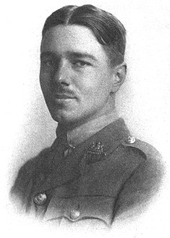
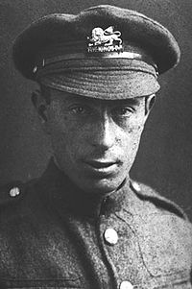
Isaac Rosenberg and Wilfred Owen

Slide 8
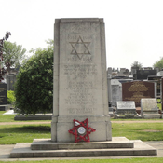
Willesden Green Jewish Cemetery War Memorial

Slide 9
Isaac Rosenberg
In The Trenches (1916)
I snatched two poppies
From the parapet’s ledge,
Two bright red poppies
That winked on the ledge.
Behind my ear
I stuck one through,
One blood red poppy
I gave to you.
The sandbags narrowed
And screwed out our jest,
And tore the poppy
You had on your breast ...
Down - a shell - O! Christ,
I am choked ... safe ... dust blind, I
See trench floor poppies
Strewn. Smashed you lie.
Break of Day in the Trenches (1916)
The darkness crumbles away.
It is the same old druid Time as ever,
Only a live thing leaps my hand,
A queer sardonic rat,
As I pull the parapet's poppy
To stick behind my ear.
Droll rat, they would shoot you if they knew
Your cosmopolitan sympathies.
Now you have touched this English hand
You will do the same to a German
Soon, no doubt, if it be your pleasure
To cross the sleeping green between.
It seems you inwardly grin as you pass
Strong eyes, fine limbs, haughty athletes,
Less chanced than you for life,
Bonds to the whims of murder,
Sprawled in the bowels of the earth,
The torn fields of France.
What do you see in our eyes
At the shrieking iron and flame
Hurled through still heavens ?
What quaver - what heart aghast?
Poppies whose roots are in man's veins
Drop, and are ever dropping;
But mine in my ear is safe -
Just a little white with the dust.

Slide 10
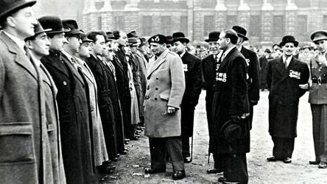
Jewish Veterans at a past AJEX Remembrance Parade being inspected by guest of honour Field Marshal Bernard (Monty) Montgomery

Slide 11
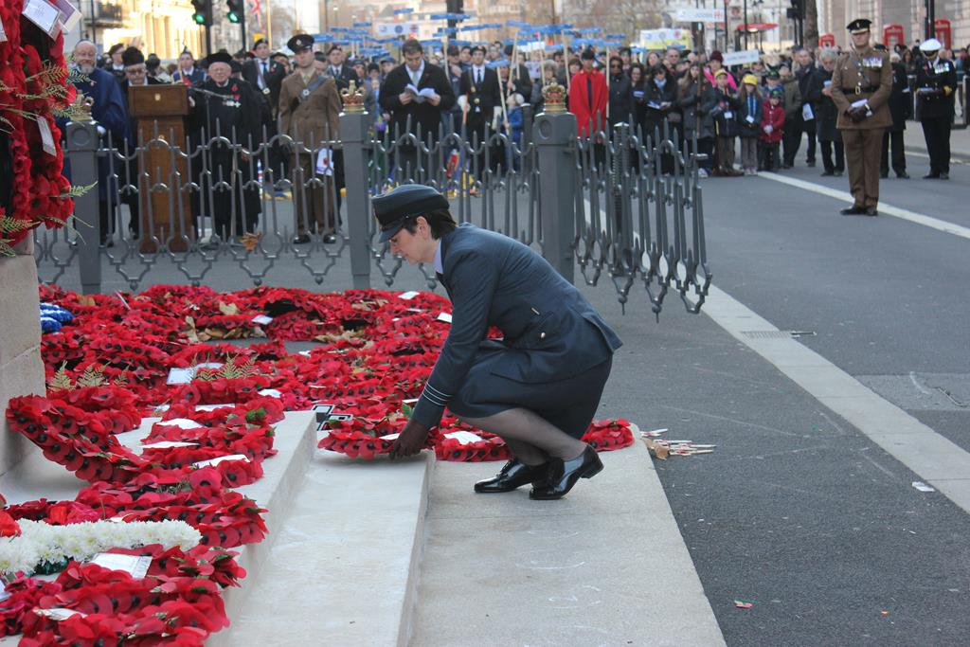
At an AJEX Parade

Slide 12
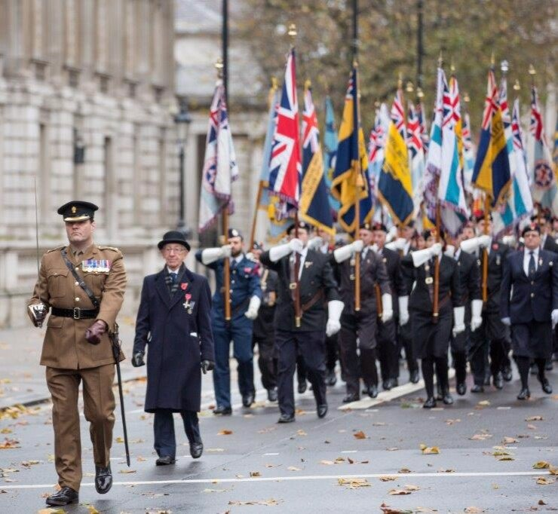
At an AJEX Parade

Slide 13
Remember Me
Remember me when I am gone away,
Gone far away into the silent land;
When you can no more hold me by the hand,
Nor I half turn to go, yet turning stay.
Remember me when no more day by day
You tell me of our future that you plann'd:
Only remember me; you understand
It will be late to counsel then or pray.
Yet if you should forget me for a while
And afterwards remember, do not grieve:
For if the darkness and corruption leave
A vestige of the thoughts that once I had,
Better by far you should forget and smile
Than that you should remember and be sad
by Christina Rossetti (1830-1894)

Slide 14

Join our Campaign of Remembrance
Why not join our Campaign of Remembrance and print off the image below and put it in your window in time for the 15th of November.

Slide 15

Profile Picture for the Campaign
You or your parents can download this image from www.ajex.org.uk and use it as a profile picture for Sunday 15th November

Slide 16
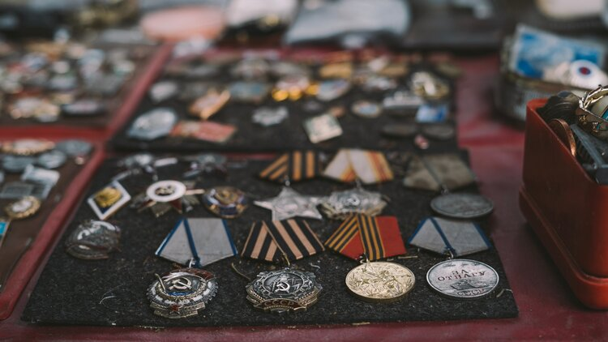
Share your photos
Share your photos of your loved ones and Jewish ex-servicemen and women. This helps to build a legacy for future generations to recognise the sacrifices and contributions of Jews to society. Please share photos of you and your family members with medals. Click below to upload and submit photos.

Slide 17

Join Us Sunday 15th November, 2.30 pm at www.youtube/AJEX_JMA

